Slide 1
Improving the User Experience with Uber’s Customer Obsession Ticket Routing Workflow and Orchestration Engine
Group 8
João Marcelo Frezzato Oliveira - 95355
Yu Cheng - 97282
Matthias Wünsch - 94888

Slide 2
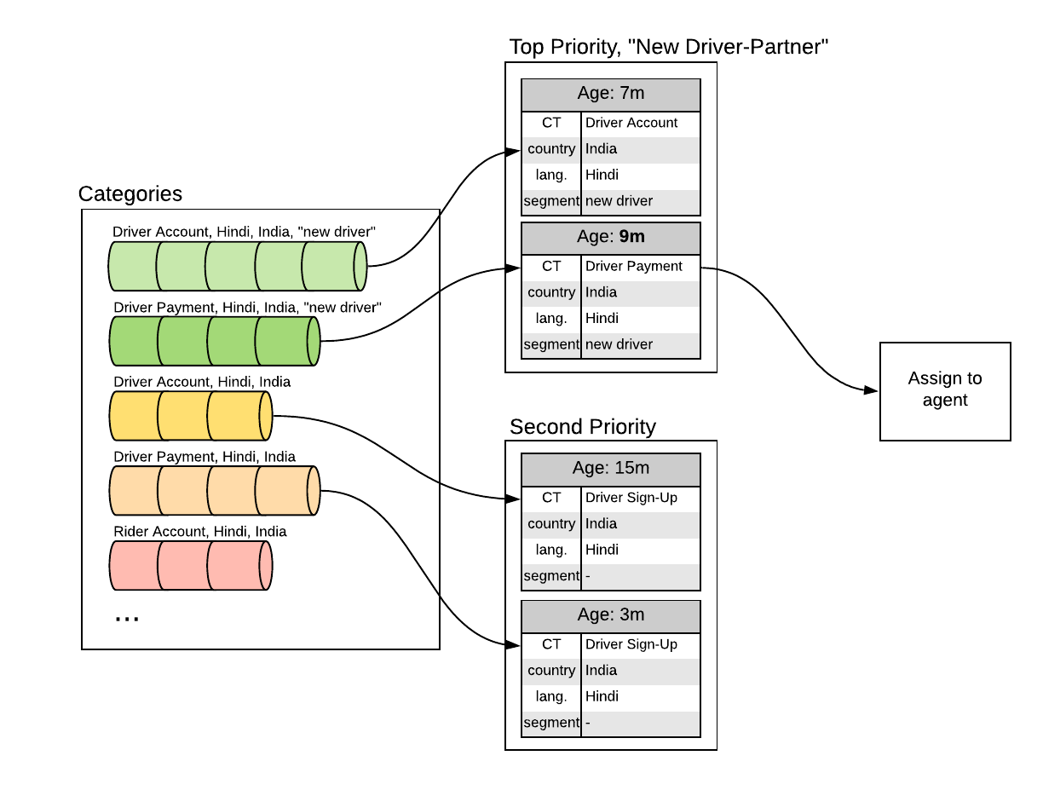
Introduction - Ticket Routing System
Notes:
Support Tickets at Uber have several attributes which are used in the routing process to direct the ticket to specific support agents.
Such attributes are: Country, Language and Ticket Type
The tickets are queued until an appropriate agent is available to handle them.
The simplest routing must considers all combinations of attributes and assign the ticket which has been waiting the longest.
Additional prioritization rules complicate this routing.

Slide 3
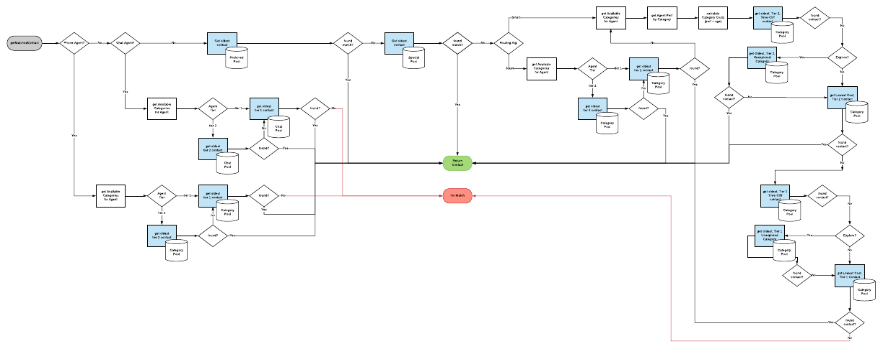
Introduction - Complexity of Routing
Notes:
This routing logic became comlex over time to satisfy all requirements.
The result was a logic that became hard to follow and harder to modify.
All the rules, prioritizations of segments and combinations of attributes lead to fragmentation which also made it less testable and more difficult to monitor.

Slide 4
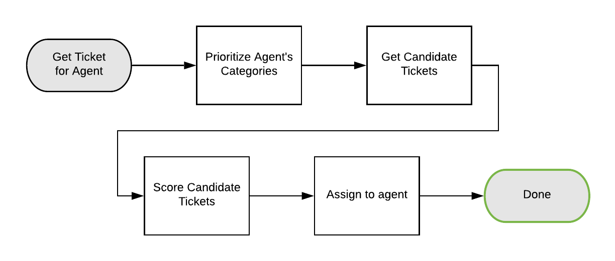
Introduction - Ticket Routing Process as Workflow
Notes:
To overcome this a flexible but stable routing platform is needed which makes it able for developers to build own routing rules to support new products and modalities.
To address the problems, the routing logic is designed as a workflow, using Cadence, Uber’s open source orchestration engine.
After the re-design of the routing process as a workflow, the control logic became much easier to understand.
These steps are: 1. Prioritize categories
2. Retrieve candidate tickets
3. Score candidate tickets
4. Assign top ticket
[Cadence enabled to seperate the control logic and modularize the business logic to make it more flexible and easier to understand.
(Advantage of Cadence: It is distributed, scalable, durable, highly available)
Cadence models use two key concepts: Workflows and Acitivities. Workflows are the coordination logic and are responsible solely for orchestrating the execution of activities. Activities are the implementation of individual tasks in the business logic.]

Slide 5
Major Stakeholders
End User
Implementer
Maintainer
Tester
Customer
Notes:
The major stakeholder identified are: The End User, who creates a ticket and is waiting for response as well as the agent who answers to the ticket
Secondly the Maintainer who maintain the system and fixes bugs
The Implementer, who is responsible for taking individual and new components and integrating them
The Tester who actual test and verifies the system on formal requirements and the architecture

Slide 6
Better code Structure : Testability
Stakeholders: Maintainer & Tester
Source: Unit tests
Stimulus: A set of tests is executed on a new scoring module
Environment: Development time
Artifact: Ticket routing system
Response: Execute test suite and capture results
Resp. Measure: Low effort to find a fault
Tactic: Limit Structural Complexity of the ticket routing system
Notes:
João

Slide 7
Supporting low latencies in workflows: Performance
Stakeholders: End User & Customer
Source: Ticket Agent
Stimulus: Agent becomes available and requests a new ticket
Environment: Normal operation
Artifact: Ticket routing system
Response: Ticket is processed with the similar latency to the old system
Resp. Measure: Latency
Tactic: Reducing the overhead from the distributed workflow execution by using local activity
Notes:
Matthias

Slide 8
Flexible prioritization logic: Modifiability
Stakeholders: Maintainer, Implementer & Customer
Source: System administrator
Stimulus: Add, remove or re-order the scoring module
Environment: Build time
Artifact: Ticket scoring step
Response: Make modification
Resp. Measure: Low effort to make the change
Tactic: Encapsulate the scoring modules and define interfaces
Notes:
Yu

